Slide 1

Track-IT
Pinak Saha & Abdul Goffar

Slide 2

What is it?
Track-IT
version 0.0.1

Slide 3
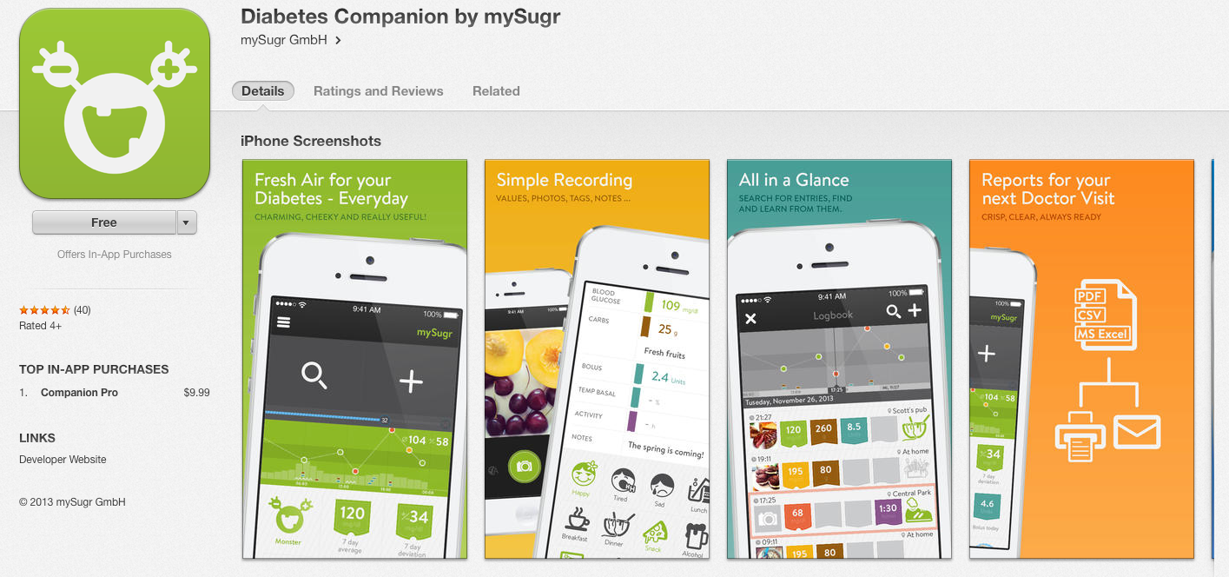
Apps that already exists …
MySugr

Slide 4
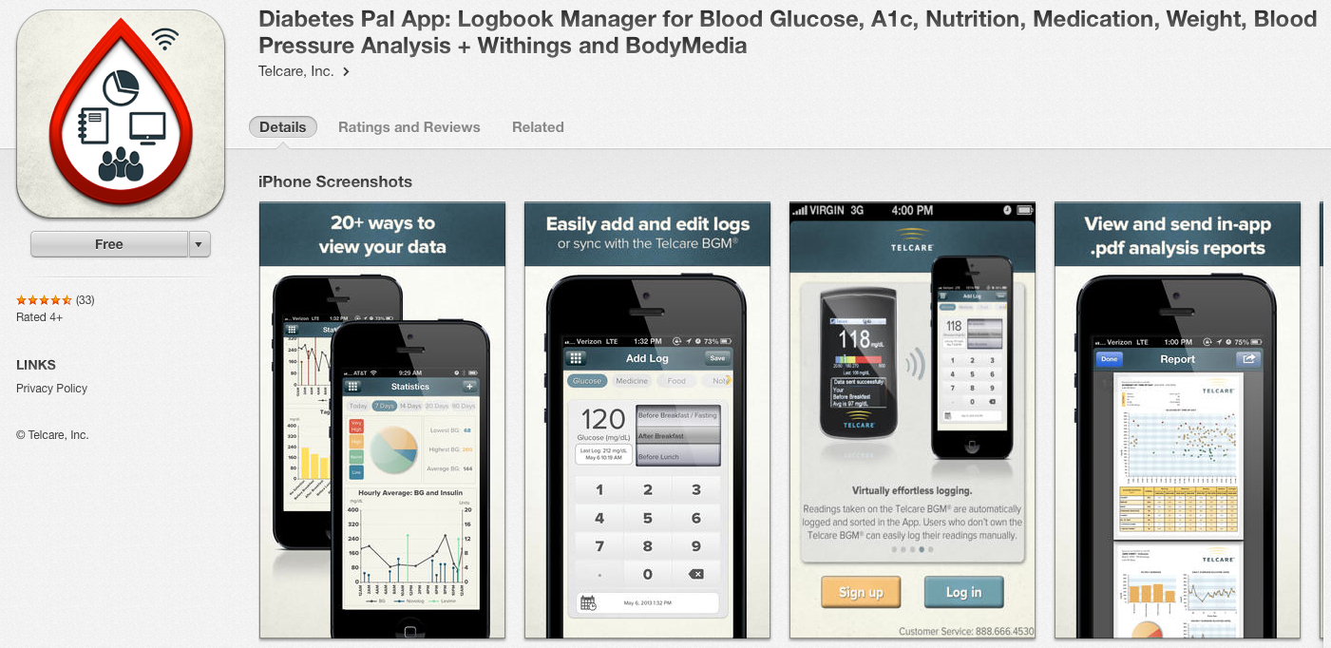
Apps that already exists …
Diabetes Pal App

Slide 5
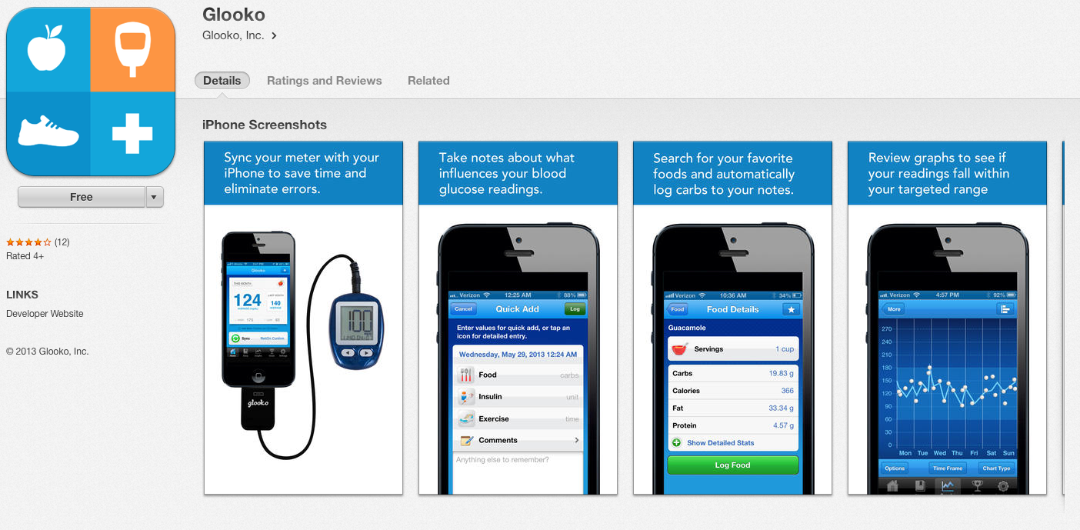
Apps that already exists …
Glooko

Slide 6
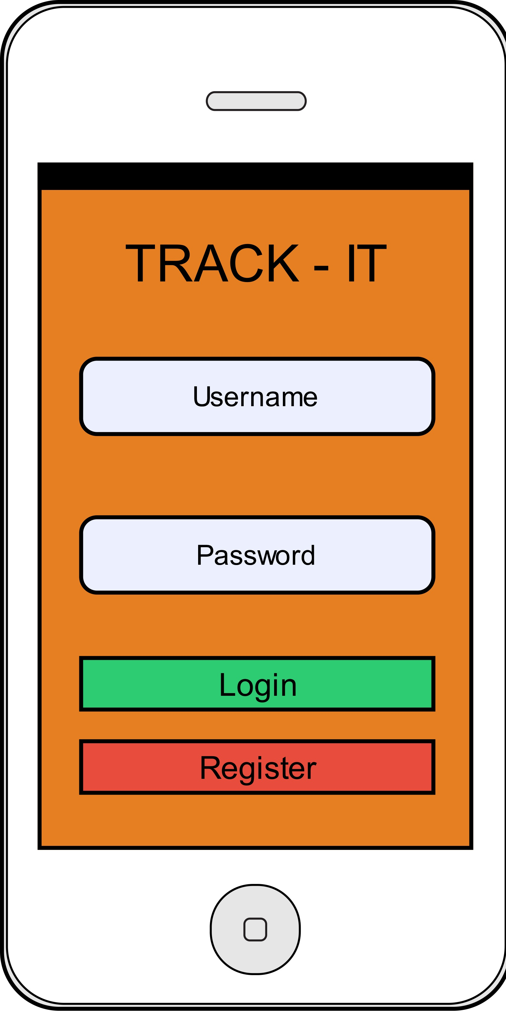
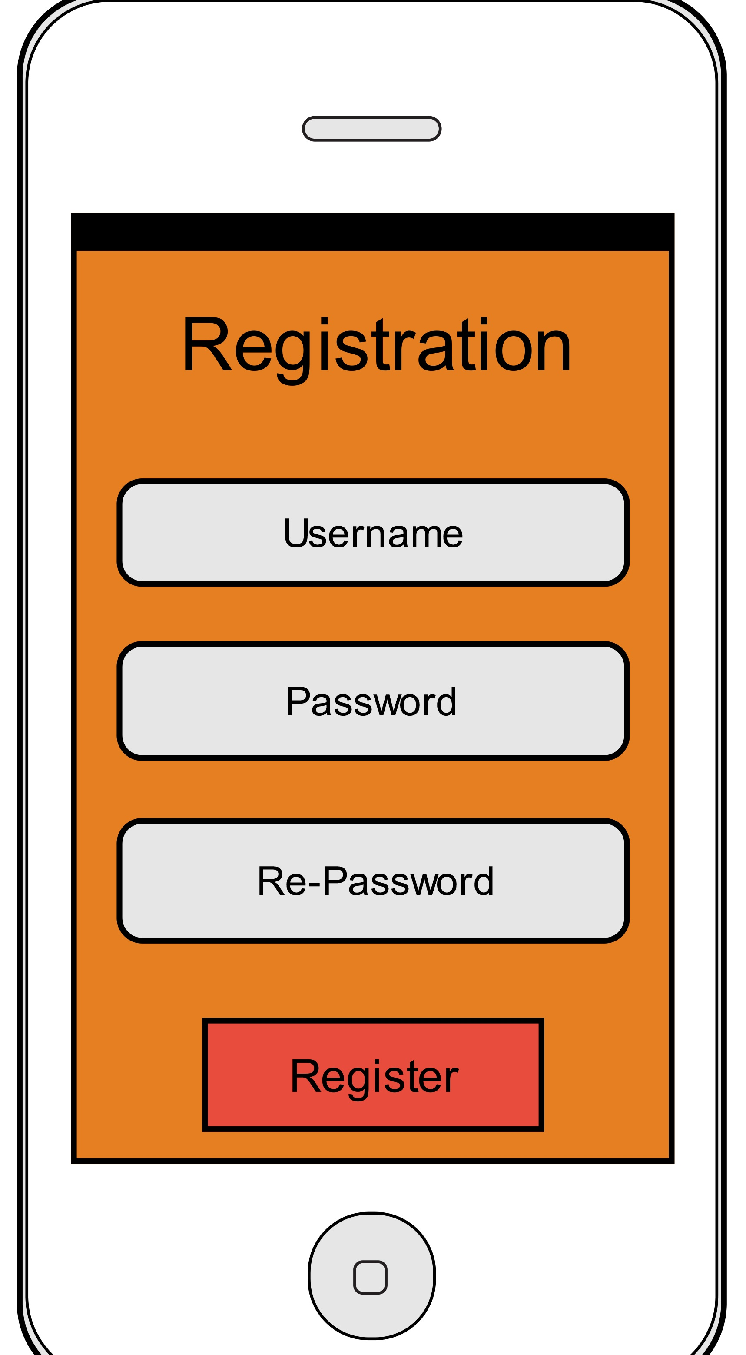
Our Solution
version 0.0.1

Slide 7
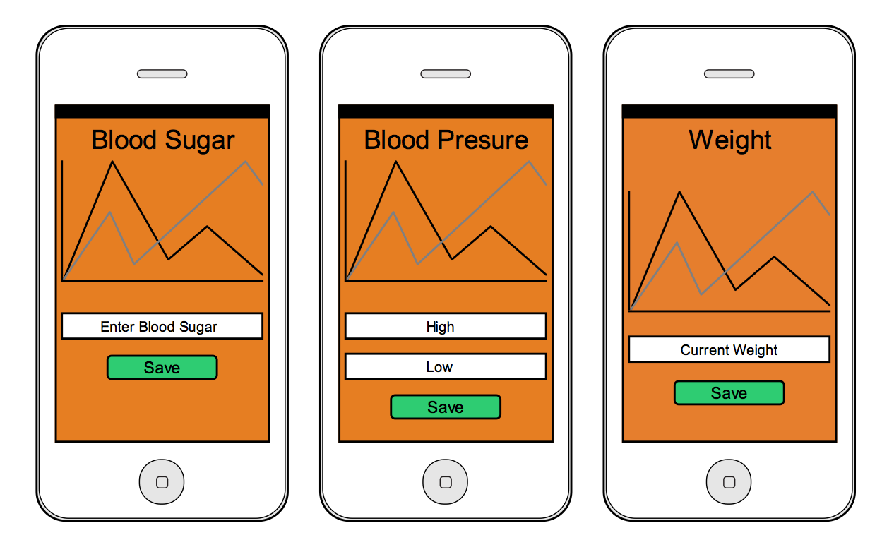
Our Solution
version 0.0.1

Slide 8
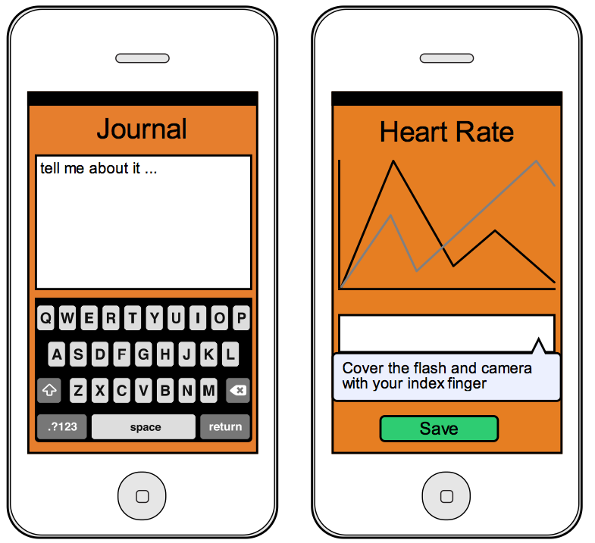
Our Solution
version 0.0.1

